Slide 1

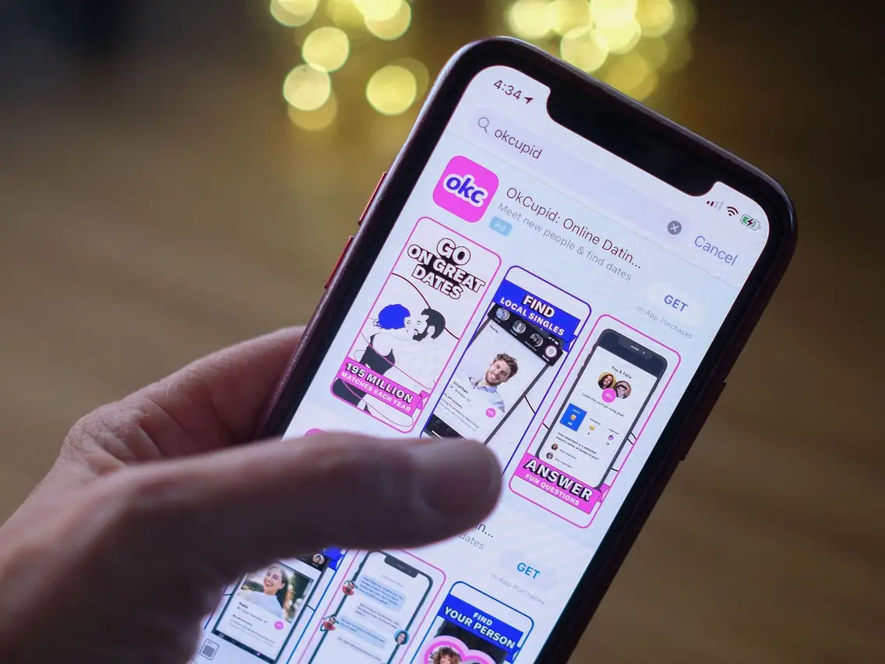
01
BEYOND SWIPING RIGHT: USER ANALYSIS OF AN OKCUPID DATASET
By Radiah Khan
Smith College ‘28

Slide 2
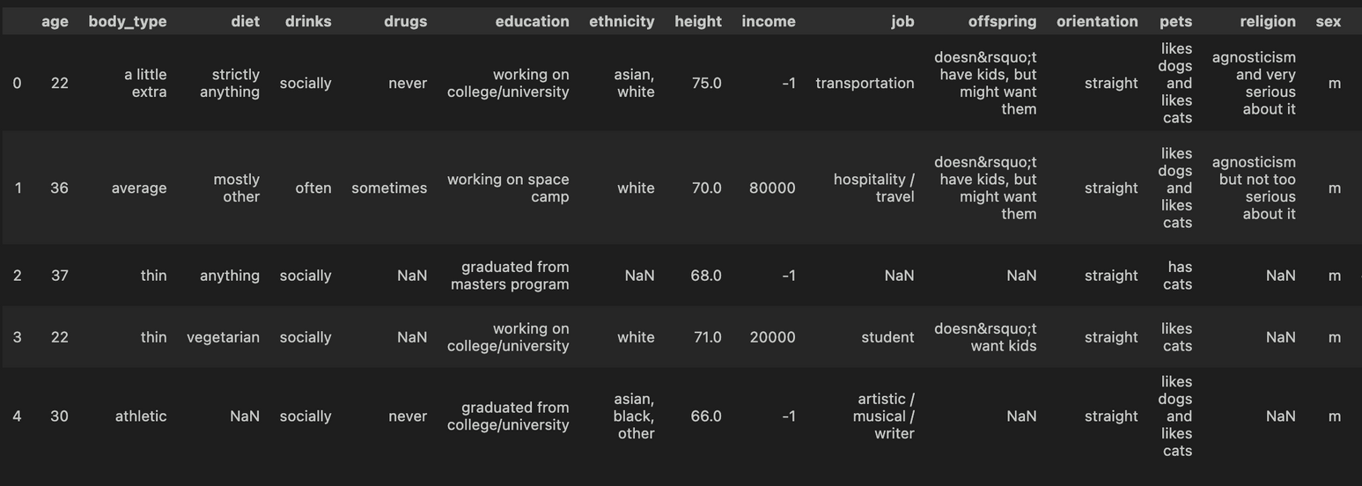
This dataset is built from information of profiles available on OkCupid. It has 59,946 San Francisco OkCupid users from a period in the 2010s. The data set includes typical user information, lifestyle variables.
02

Slide 3
WHY THIS DATASET?
Modern-day dating apps reveal different aspects of how relationships have evolved over time. Millions of people have switched to online dating in the last few years.
We are interested in exploring the audience who were involved in this particular dataset by their ethnicities, sex, sexual orientation, lifestyle choices, and education level.
We are also interested to see how much stereotypical assumptions (every woman wanting kids, or queer people not wanting kids) hold up in predicting parental choices.
Finally, we want to see how coherent people are when they are self-reporting their lifestyle choices in this app.
03

Slide 4

Exploring the dataset to see
how diverse they are and identifying
any limitation in data
WHY THIS DATASET?
To understand user
behavior based
on the choices they make
How reliable are
those choices in predicting
their behavior
03

Slide 5
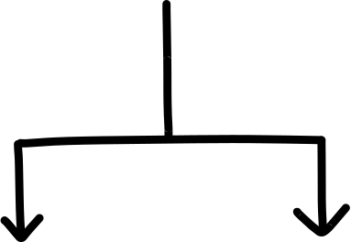

ANALYSIS TOOLS
Python
R Studio
Packages : NumPy, Pandas, Seaborn, Matplotlib,IsolationForest
Packages : tidyverse, dplyr, gam, ggplot2, pROC,
03
Github

Slide 6
05
Ethnicity, Sex
EXPLORATORY DATA ANALYSIS

Slide 7
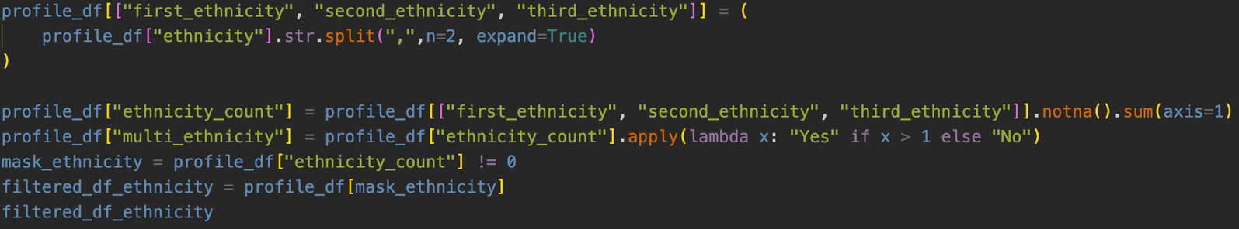
CLEANING AND PREPARING THE DATA
Because some users listed multiple ethnicities separated by commas, we used a string delimiter to split those entries into separate columns. Specifically, we created five new variables:
  first_ethnicity, second_ethnicity, and third_ethnicity represent the first, second, and third reported ethnicities.
  ethnicity_count records the total number of ethnicities listed by each user
Later we filtered the NaN value.

Slide 8
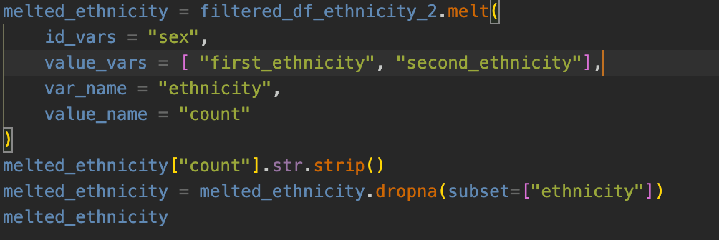
CLEANING AND PREPARING THE DATA
We melted the dataset into a long format keeping the column sex as it is. One thing to note that is : we did not keep the third ethnicities because of their low count. And then we filtered to keep only the non-empty values.

Slide 9
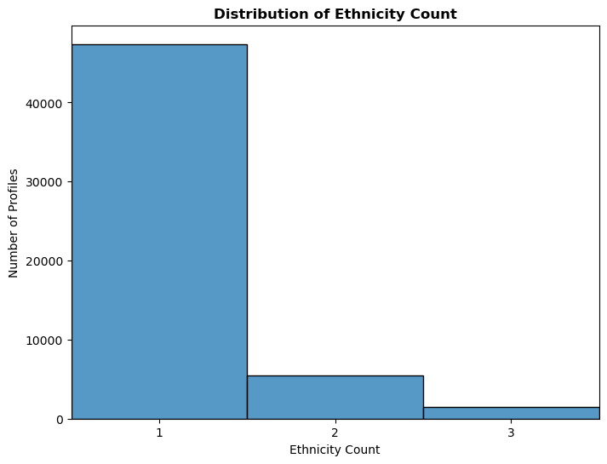
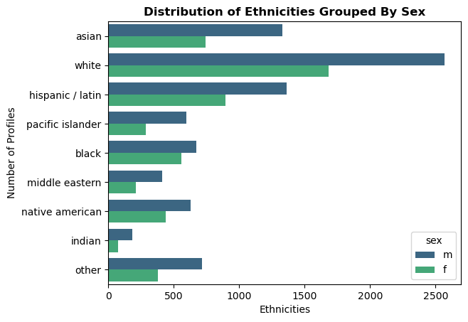

Figure 1: Representation of singular and multi ethnicities
Figure 2: Distribution of different ethnicities among male and female
From Figure 1, we can see that most profiles report a single ethnicity. Figure 2 reveals that the majority of profiles represent white males. This is a critical observation because unbiased data collection is essential for producing generalized results. As shown in Figure 2, there is significantly lower representation of Black, Middle Eastern, Indian, and Pacific Islander demographics compared to White, Hispanic, and Asian populations. Furthermore, female representation is consistently lower across all racial categories. These disparities highlight underrepresentation, where both race and gender contribute.

Slide 10
05
Body Type, Sex, Sexual Orientation
EXPLORATORY DATA ANALYSIS

Slide 11
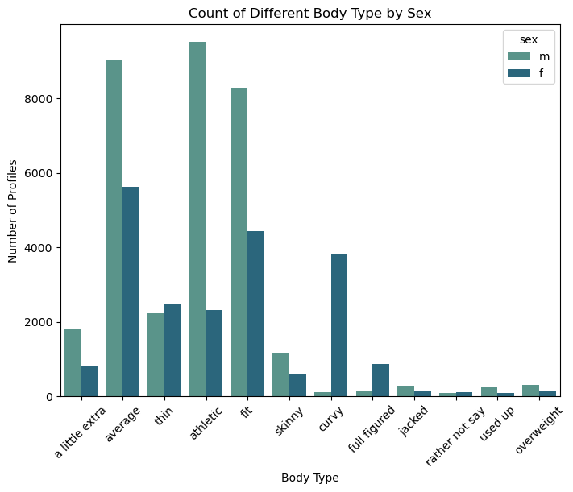
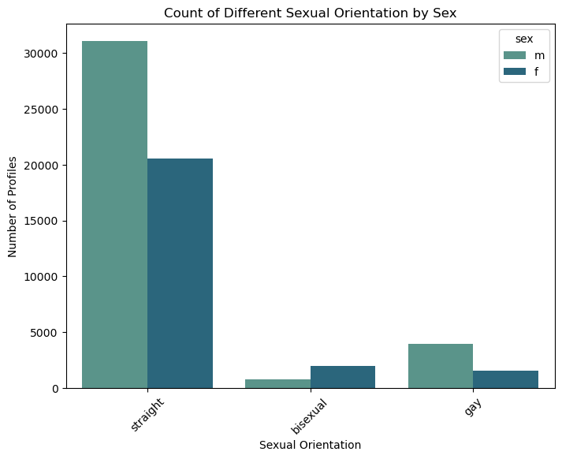
Figure 3 : Count of Profiles for different body type by sex
Figure 4 : Count of profiles of three different sexual orientation by sex
From figure 3 and Figure 4, we can see that more men are likely to report their body type and sexual orientation on OkCupid. In the first plot
the reports of being average, fit, athletic body type is more than other body types.Women reported curvy more which is understandable in context of curvy being associated with women. In the second plot, the profiles which reported gay were the least. This distribution may indicate either true user base composition or potential underreporting due to social stigma regarding body types/sexual orientation/ lack of security for homesexual identity.

Slide 12
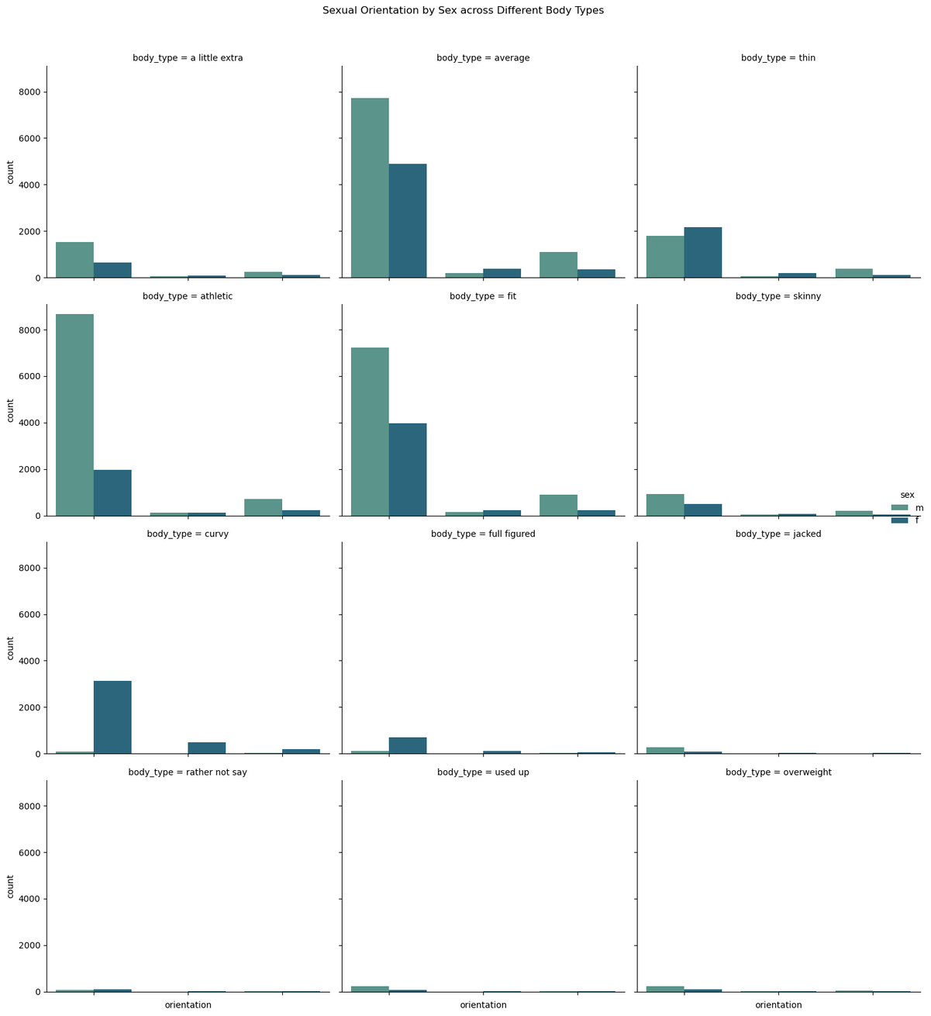
This figure combines the two plots and shows us a comprehensive analysis of how different body types are represented among Male and Female across three different sexual orientation.
As expected from the figure 3 and figure 4, overweight, used up, jacked body type has less data. One key observation is full figured body type has more heterosexual male reported than women or queer people.
A societal bias on conventional beauty standards that cater to thin bodies might be a factor here. Additionally, heteronormativity can be a factor here too.

Slide 13
05
Age,Income
EXPLORATORY DATA ANALYSIS

Slide 14
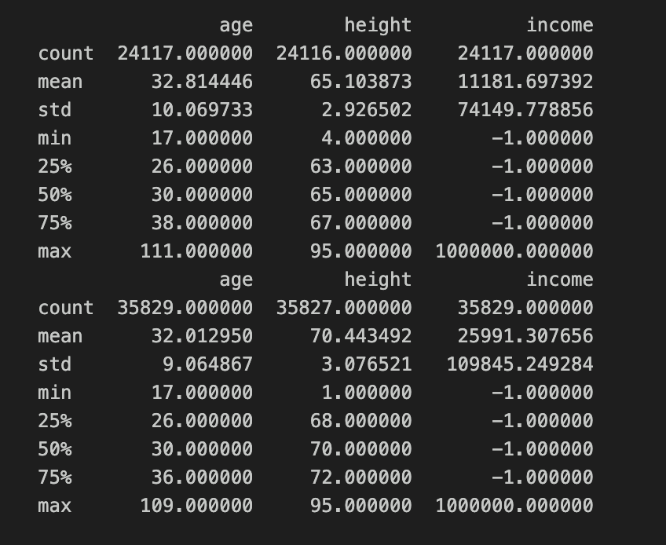
SUMMARY STATISTICS
The table displays descriptive statistics (mean, median, standard deviation, etc.) for age, income, and height, separated by sex.
The first summary is for female users and the second summary is for male users.

Slide 15
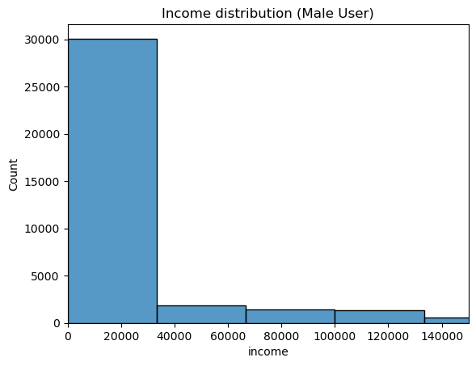
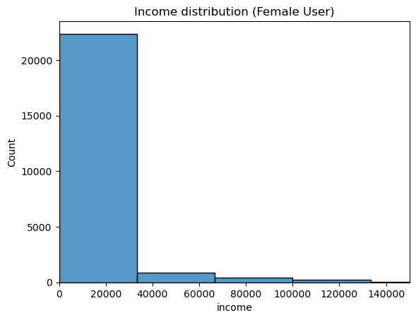
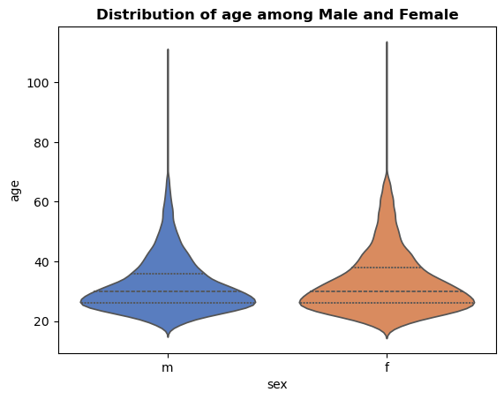
Figure 6 : Distribution of age in the dataset
Figure 7: Distribution of income for male users
Figure 8: Distribution of income for Female users
From figure 6: we can see that the age is similarly distributed among male and female users except outliers. Eliminating any age bias that might skew results. From figure 7 and 8, we can see that the majority users belong to male and female users making less than 40k indicating there is less representation of users making more than 100K. The factors contributing to this is the socio economic context of SF at that time.
Overall, we can say that the balance of age and income is similar for both categories of users.

Slide 16
05
Educational Level,
Sex
ASSOCIATION

Slide 17
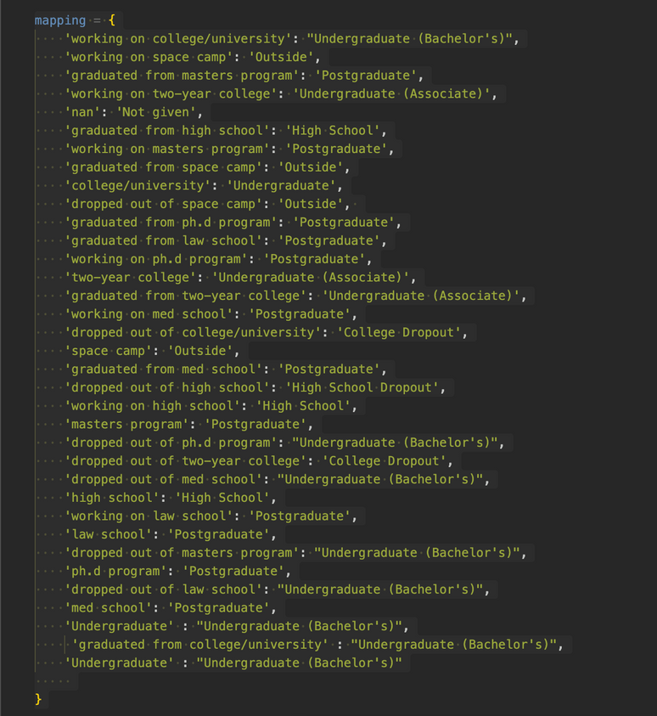
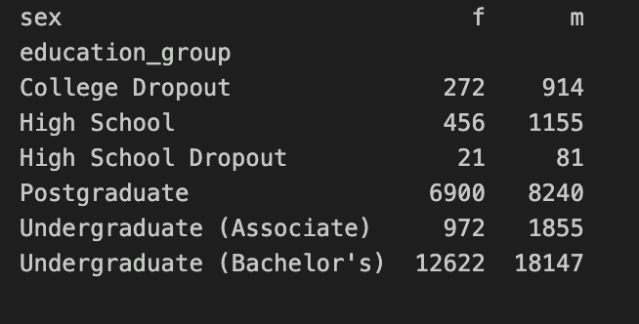
CLEANING AND PREPARING THE DATA
The educational groups reported by users were messy and not categorizable. Using mapping, we mapped each unique answers to seven education groups. Later we excluded people in the job force to only keep it education specific. The filtered educational levels are : ["Undergraduate (Bachelor's)", 'Postgraduate', 'Undergraduate (Associate)','High School', 'College Dropout', 'High School Dropout']
For identifying any possible association between these two categorical variable – we set up a contigency table using the pd.crosstab() function.

Slide 18
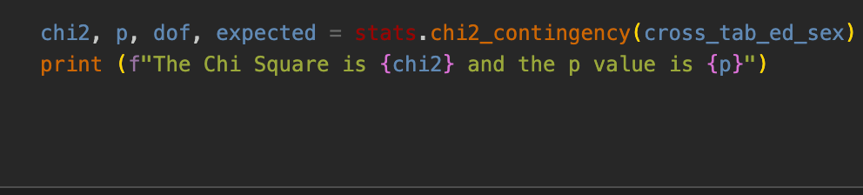
ASSOCIATION TEST
We will use Chi-Square test of independence to see if there is any relationship between sex and educational level.
Null Hypothesis : There is no association between sex and educational level in the dating app.
Alternative Hypothesis : There is association between sex and educational level in the dating app.
With a 95% confidence interval and a significance level of α = 0.05, the p-value is less than 0.05, leading us to reject the null hypothesis. This indicates a significant association between sex and educational level. To identify which specific educational groups contribute to this association, we can conduct a Bonferroni correction method for post-hoc pairwise comparisons.

Slide 19
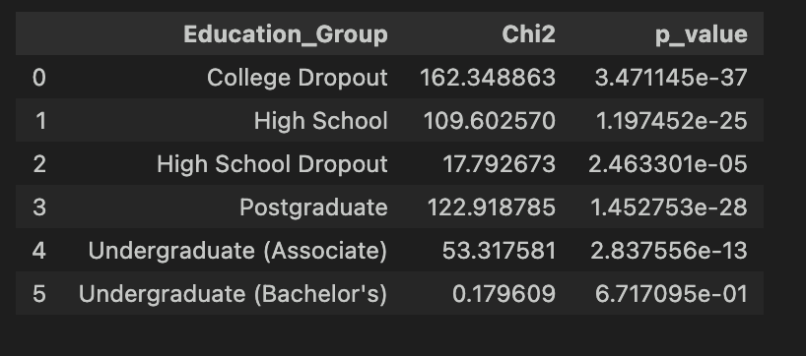
POST HOC PAIRWISE COMPARISON
Given there are 6 groups so the corrected significance level is now is 0.008333333333333333 according to the Bonferonni Correction Method.
After looping through each of the educational level.
if the p-value is lesser than 0.008
the association will be significant
for that group
We can see that the college dropout group shows a
significant association between sex and educational levell

Slide 20
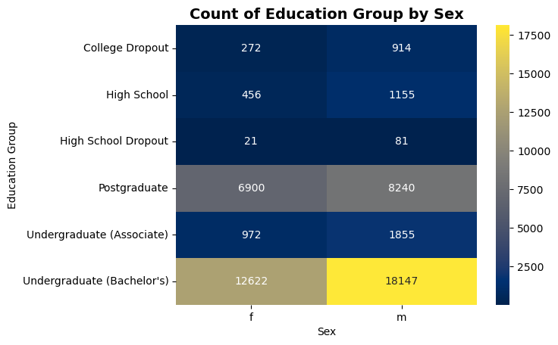
Figure 5 : Count of Profiles for different education group by Sex
Figure 5 clearly shows this association. Males are significantly overrepresented in the college dropout group compared to females. The differential distribution of educational levels between sexes contributes to the overall gender imbalance observed in the dataset.

Slide 21
05
PREDICTING INDIVIDUAL CHOICES BY IDENTITY

Slide 22
WAIT BUT WHY ARE WE INTERESTED IN
PREDICTING PERSONAL CHOICES BY THEIR INDIVIDUAL IDENTITY?
The purpose of this analysis is to understand user behavior and understand assumption biases society holds about different demographics. Questions such as whether women or men are more likely to want kids in the future remain matters of debate. These are questions people bring different biases to when using dating apps. Some users might rely on their personal assumptions and presume someone wants kids based on their sex. Through logistic regression, we aim to determine whether any factors like this is actually strong predictors of wanting children, or if such assumptions are not statistically relevant.

Slide 23
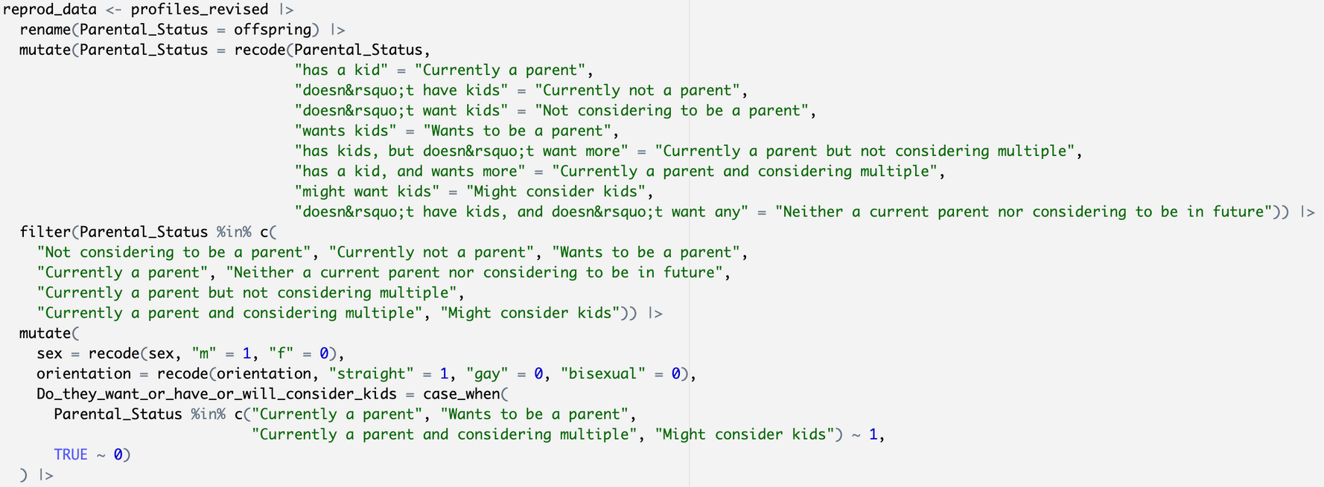
CLEANING AND PREPARING THE DATA
For preparing the dataset for the prediction models, we start by mutating variable names and making dummy variables for categorizing reproduction choices. For everyone who would ever want a kid in future we assigned 1 to them. Note that, since the prediction is for future-- everyone who did not want a kid despite having a kid in present were marked 0. We will delve more into the variable in the next slides for the prediction models.

Slide 24
CAN SEX PREDICT WHETHER SOMEONE WANTS/HAS/WILL CONSIDER KIDS?
Predictor Variable : Sex
M = 1
F = 0
Outcome Variable : Do they want kids?
Yes = 1
No = 0

Slide 25
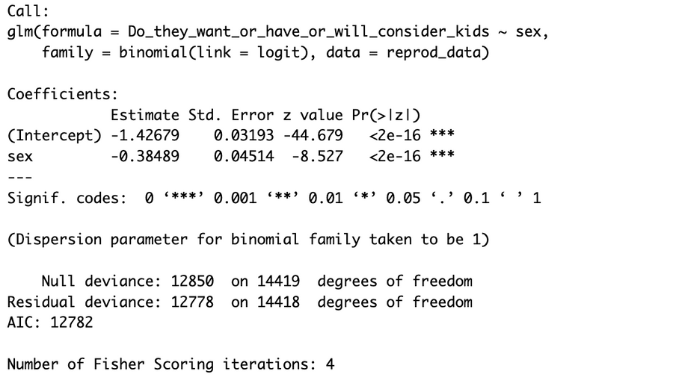
FITTING THE MODEL
We will fit a logistical regression model to see if there is any relationship between sex and wanting to be a parent.
Null Hypothesis : Sex does not significantly predict whether users want, or will consider having children.
Alternative Hypothesis: Sex significantly predicts whether users want, or will consider having children.
Taking sex as the predictor variable and willingness to want/consider kids as the outcome variable - we fitted the logistial regression model where both of these variables are binary variable. With 95% confidence interval with the significance level of 0.05 – the p-value is less than 0.05. So it is statistically significant. However, statistical significance alone does not indicate predictive accuracy. To assess the model's ability to correctly classify users who want children, we calculated the AUC. The AUC will provide us a measure of how well sex can distinguish between users who want children and those who do not.

Slide 26
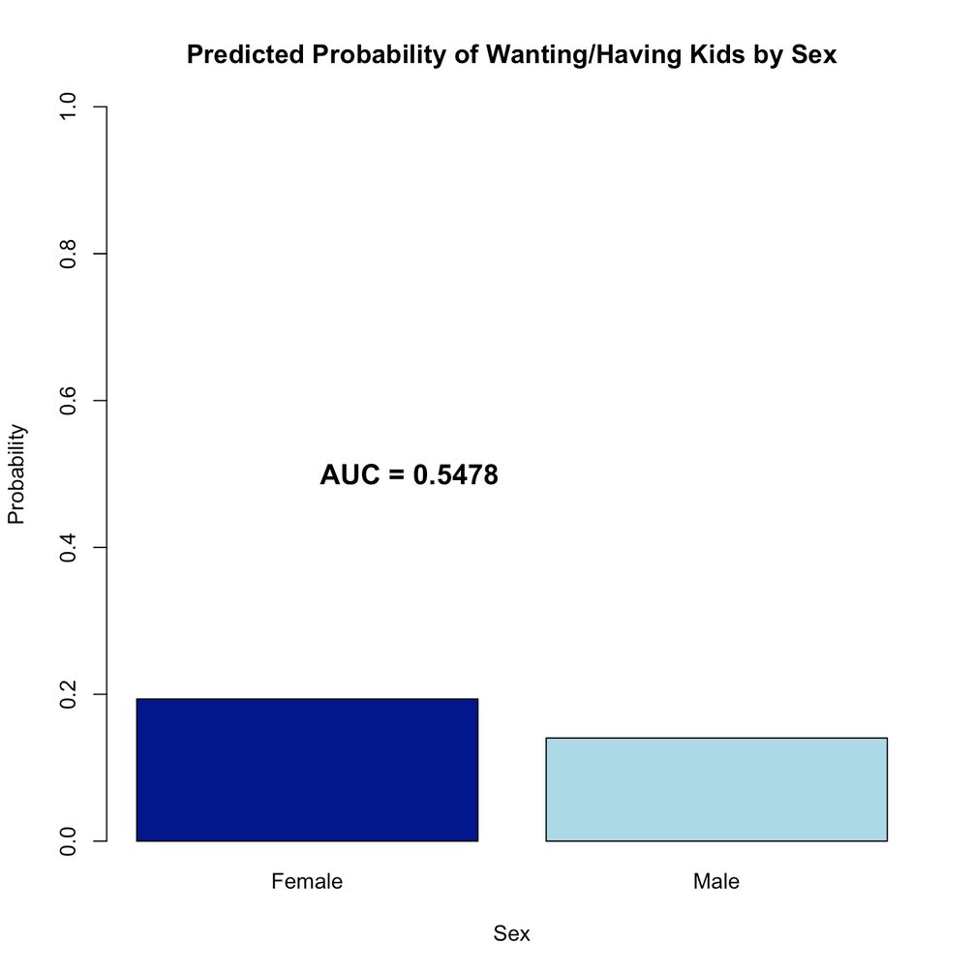
This figure tells us that the AUC of this prediction model is 0.5478 which is slightly over the baseline of 0.5.
So this model has really weak predictve power when it comes to distinguishing if it is male or female when it comes to wanting/considering kids.
But why is that? Because of the effect size being small, less data on female demographic – might be a factor for this. Hence sex alone cannot predict if someone wants/considers kids.

Slide 27
SO WHAT CAN WE SAY ABOUT PREDICTING PARENTAL CHOICE?
We can see that sex is a weak predictor when it comes to predicting if they want/consider kids even
though the results come out as statistically significant.
Societal assumptions that women are "naturally" inclined to want children have significantly shaped perceptions and expectations. However, this model demonstrates that we cannot reliably predict someone's desire for children based solely on their sex. This finding challenges common stereotypes and highlights the danger of making assumptions about individuals based on demographic. On dating platforms, where users may unconsciously filter potential matches based on such assumptions, these results underscore the importance of considering individual preferences rather than relying on sterotypical expectations.

Slide 28
05
RED FLAG DETECTION

Slide 29
BEFORE DIVING INTO DETECTING RED FLAGS
How consistent are human choices? Someone who said they prefer being vegan for healthy lifestyle might answer for another lifestyle specific question that they smoke a lot. This can confuse users who simply wants someone who leads a healthy lifestyle in all meaning.
To detect inconsistencies in user responses, we employed the Isolation Forest anomaly detection algorithm to identify profiles with unusual patterns related to healthy lifestyle indicators (‘diet', 'drinks', 'smokes', 'drugs')

Slide 30
WHY ISOLATIONFOREST?
For other algorithms that we did not choose, we needed to specify what we prefer as healthy and make mutliple combinations that is way more time consuming, less efficient and prone to excluding any possible combination from these variables. So we use IsolationForest which works as a binary tree by drawing random trees over and oever again. It works faster than the other algorithms specifically for our targetted research question for detecting any inconsistencies in lifestyle behavior.

Slide 31
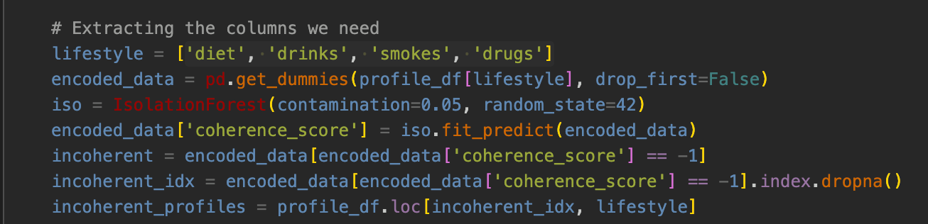
PREPARING THE DATA
For preparing the dataset for the detection, we start by dummy coding all the possible combinations
of the four variables that we chose. It converts the responses of the variables into binary columns. We expect 5% of profiles to be anomalies – that flags any potential inconsistencies.

Slide 32
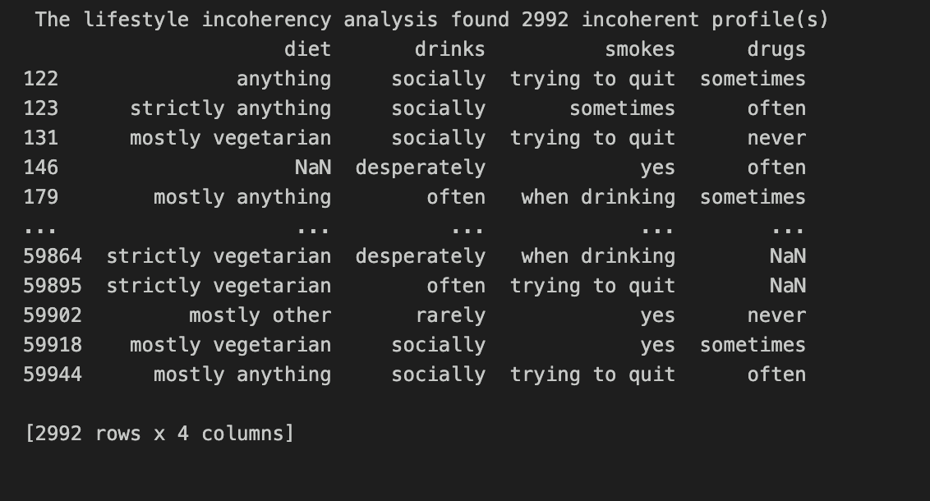
RESULTS
The algorithm points out to 2992 incoherent profiles which is a red flag for healthy lifestyle
consistency. For example, someone who is strictly vegetarian (asumming for health concern) drinking often might be a red flag for someone who is looking for a vegan partner with a healthy lifestyle. Ofcourse can be an individual choice; however this detection can be useful for people on the dating app prioritizing lifestyle compatibility.

Slide 33
CONNECTING IT ALL
OKCUPID DEMOGRAPHIC
Our exploratory data analysis reflected significant representation gaps in the dataset. The dataset was heavily dominated by white males. This imbalance reflected in our further analysises and brings us to a question on how much of dating apps’ algorithms are being catered towards underpressented communities.
The association between sex and education level show significant association, with men overrepresented in being college dropouts. These patterns suggest that who uses dating apps, and how they present themselves, varies systematically by demographic group.

Slide 34
CONNECTING IT ALL
STEROTYPICAL ASSUMPTIONS AND PARENTAL CHOICE
While logistic regression confirmed that sex is statistically associated with wanting children, the model's low AUC demonstrates weak ability to distinguish .
While societal stereotypes are statistically detectable in the data, they lack the predictive power needed for individual-level inference. Statistical significance does not equal practical decisions. And we should be careful about it while designing machine learning algorithms.

Slide 35
CONNECTING IT ALL
CONSISTENCY IN CHOICES
Modern dating is not an one size fits all algorithm. Human being are prone to contradict themselves often. As seen in our lifestyle inconsistency analysis – one answer to a prompt on a dating app cannot be a true compatibility indicator.

Slide 36
05
WHAT ELSE WOULD I HAVE DONE BETTER HERE?

Slide 37
  Analysing which prompts are more useful
2. Analyzing the essay-based responses
If the dataset also had information on who matched with who and by which prompt(if they swiped right on essay responses or prompt responses)
We could have analyzed the rates of each prompts getting responses and do an analysis
With the essay based responses, I wanted to qualitatively code the keywords from the responses and get a list of words that were common. Extracting the themes out of those words- there could be a analysis on how men and women express themselves differently in these dating sites.
3. Making a compatibility score checker
Assigning a score based system on each people’s answer (sort of like a buzzfeed quiz), making a feature for user to check how compatible they are with the person they are swiping on based on their answers.

Slide 38
Thank you!

